Slide 1



Foreign Direct Investment Analytics
View in Power BI
Last data refresh:
4/15/2024 7:10:31 AM UTC
Downloaded at:
4/15/2024 7:15:40 AM UTC

Slide 2
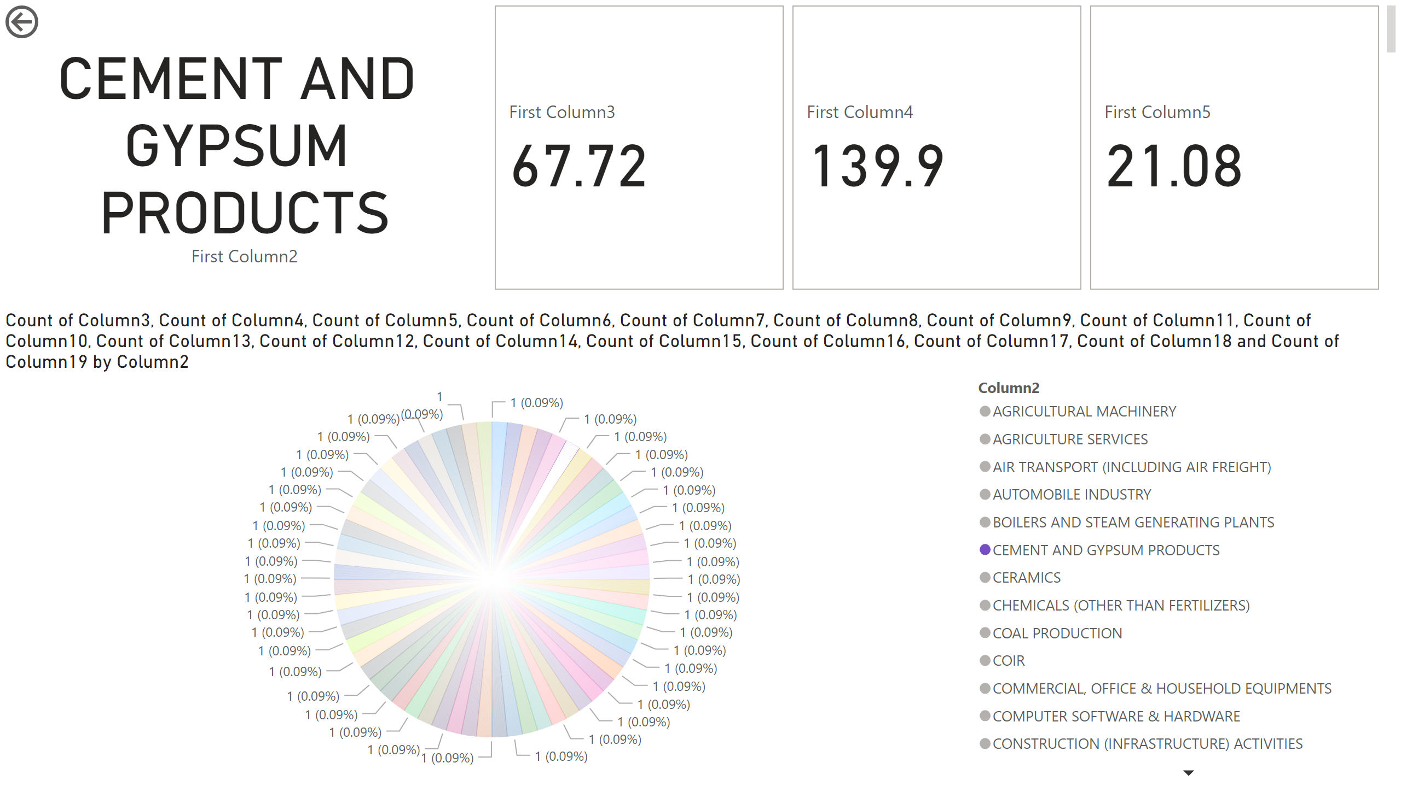
Page 1
Notes:
card
No alt text provided
pieChart
No alt text provided
cardVisual
No alt text provided
actionButton
No alt text provided

Slide 3
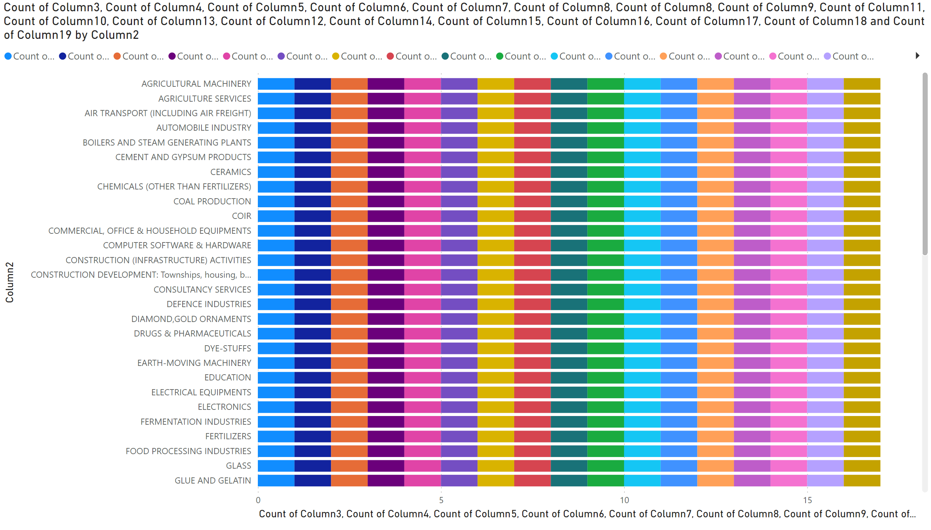
Page 2
Notes:
barChart
No alt text provided

Slide 4
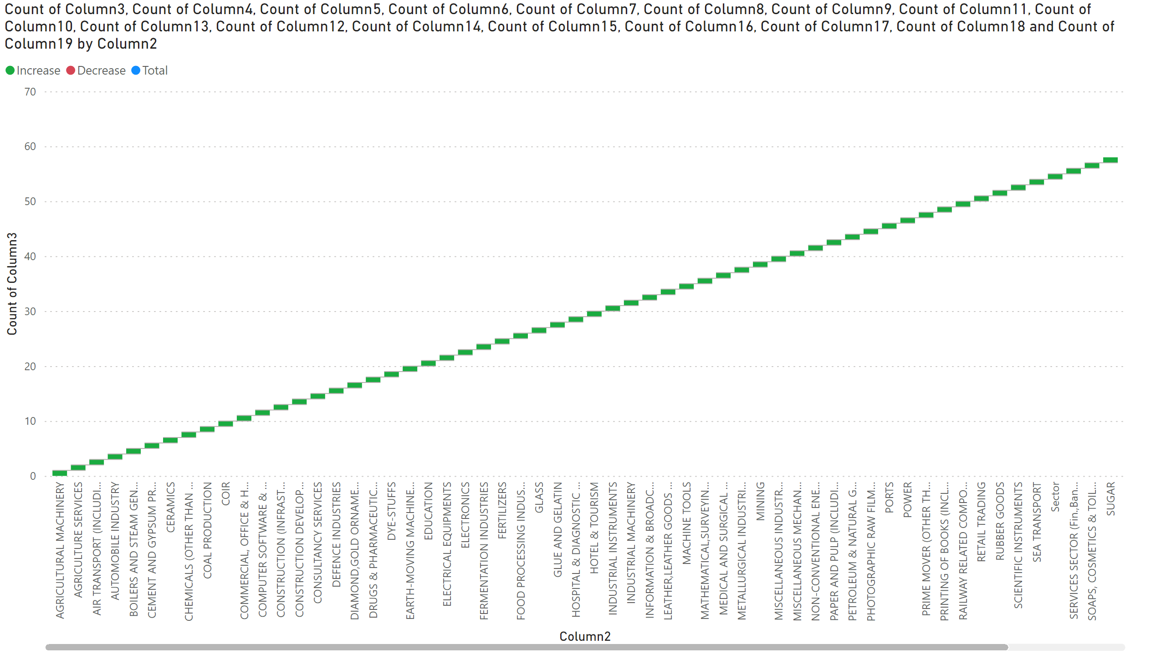
Page 3
Notes:
waterfallChart
No alt text provided

